Slide 1
ML Platform Components

Slide 2

JupyterHub
JupyterHub brings the power of notebooks to groups of users. It gives users access to computational environments and resources without burdening the users with installation and maintenance tasks.
JupyterHub runs in the cloud or on your own hardware, and makes it possible to serve a pre-configured data science environment to any user in the world. It is customizable and scalable, and is suitable for small and large teams, academic courses, and large-scale infrastructure.

Slide 3
The Cask Data Application Platform (CDAP)
CDAP is a Unified Integration Platform for Big Data applications. It provides simple, easy-to-use abstractions to process and analyze huge datasets, without having to write and debug low-level code.
It integrates the latest Big Data technologies from data integration, discovery and data science to app development, security, operations and governance.
CDAP provides two visual interfaces for working with data:
Data Preparation
Data Pipeline

Slide 4
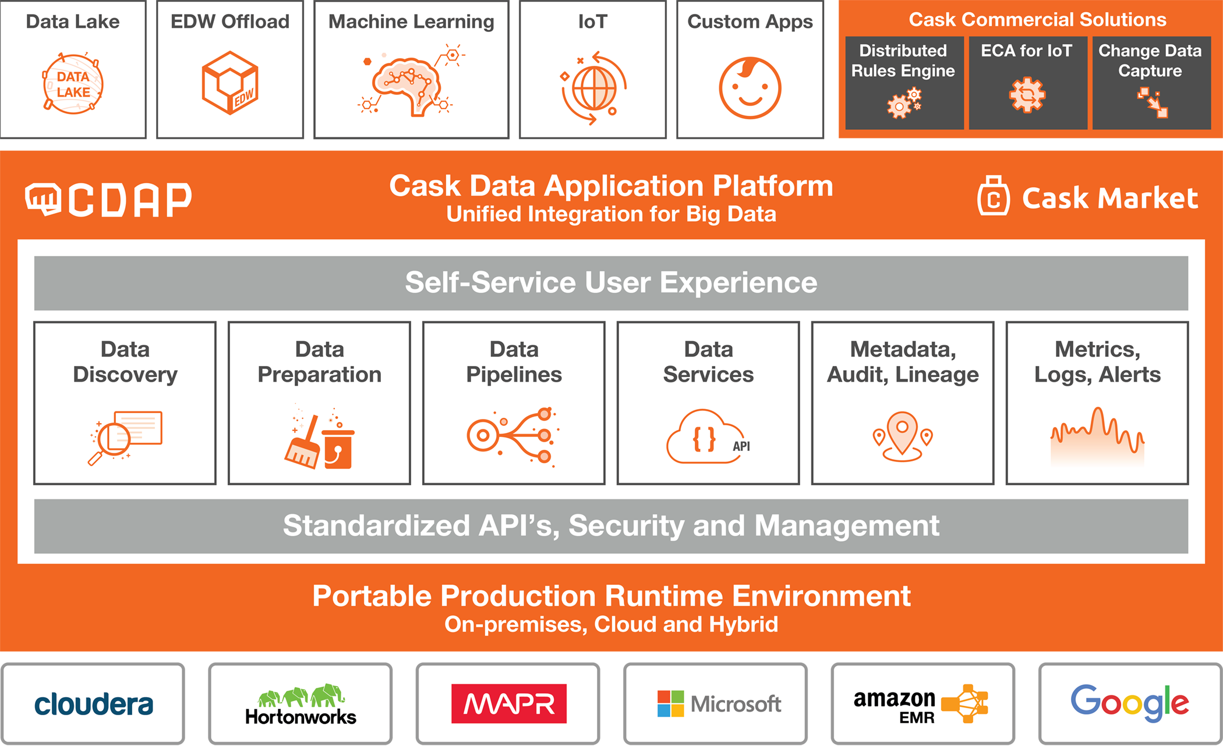

Slide 5
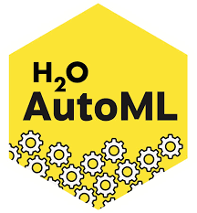
H20 AutoML
H2O is a fully open-source, distributed in-memory machine learning platform. H2O supports the most widely used statistical & machine learning algorithms, including gradient boosted machines, generalized linear models, deep learning, and many more.
Automate the process of building a large number of models, to find the “best” model without any prior knowledge. H2O AutoML can be used for automating the machine learning workflow, which includes automatic training and tuning of many models within a user-specified time-limit.

Slide 6
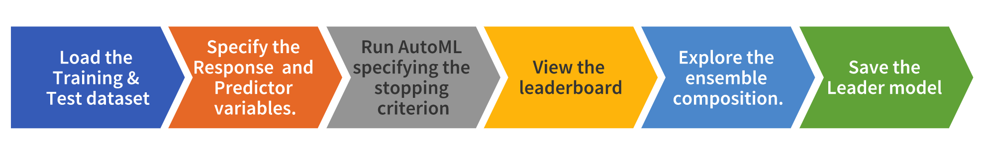
H20 AutoML Features

Slide 7
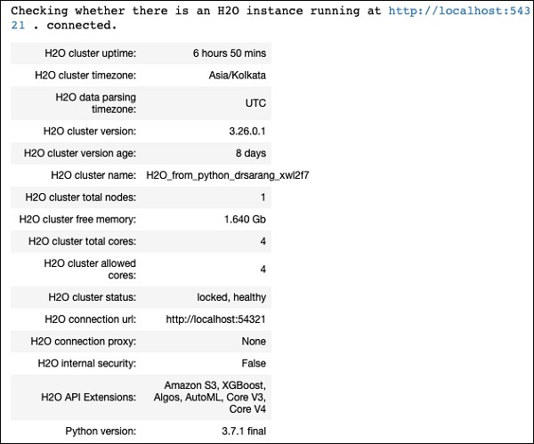
H20 AutoML Instance
Initialize H2O
H2o.init()

Slide 8
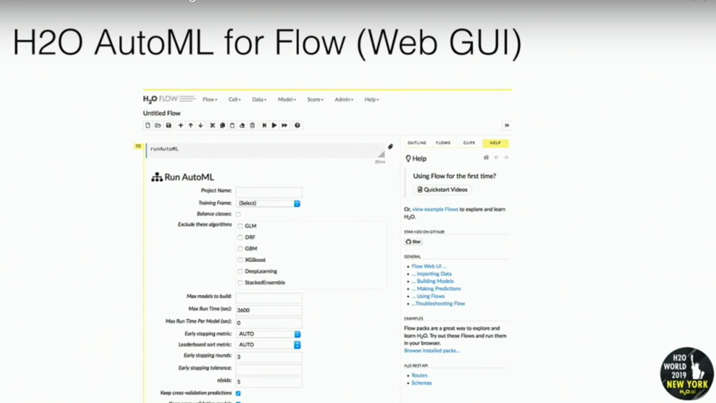

Slide 9

MLflow is an open source platform for managing the end-to-end machine learning lifecycle.
MLflow is library-agnostic. You can use it with any machine learning library, and in any programming language, since all functions are accessible through a REST API and CLI. For convenience, the project also includes a Python API, R API, and Java API.
By default, wherever you run your program, the tracking API writes data into files into a local ./mlruns directory. You can then run MLflow’s Tracking UI.
mlflow ui
view it at http://localhost:5000.

Slide 10
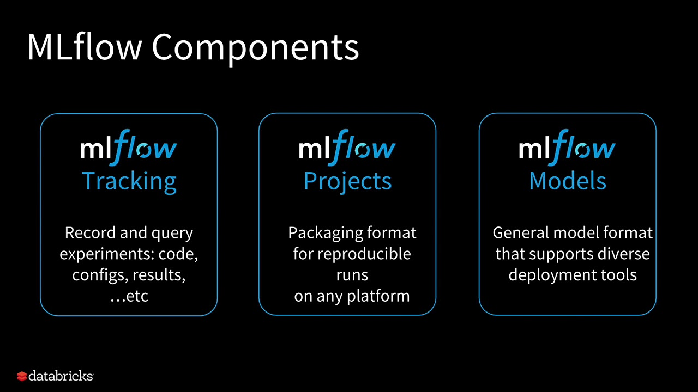

Slide 11

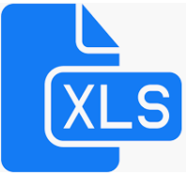


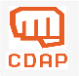

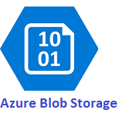
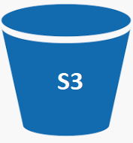

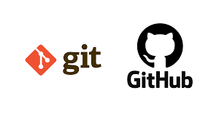
ML Platform Integration
Acquire
Data Sources
Organize
Analyze
Deliver
Automatic Machine Learning
Data Repository
Clean
Transform
Enrich
Custom
UI
REST API
Distributed
Data Preparation
HDFS
NoSql
Other
Automatic Feature Selection
Machine Learning Models
Optimum ML Model
HDFS
Monolithic
Model Evaluation
RDBMS
Sql
NoSql
Cloud Storage
JupyterHub
Deploy/Save
Model
Sql
JupyterHub
JupyterHub
Prediction
Files

Slide 12
JupyterHub
Mlflow UI
Select best model
Model test
Model Re-train
CDAP
H2O AutoML
Trained Models
H2O
AutoML
1
Variable
Importance
2
Leaderboard
Mlflow
Parameter
Matrix
Artifacts
Output Dir.
CDAP
Pipeline
REST API
POST
PUT
JupyterHub

Slide 13

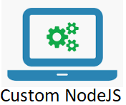

Target Technical Architecture
Acquire
Data Sources
Organize
Analyze
Deliver
Automatic Machine Learning
Custom
UI
REST API
Distributed
Druid??
HDFS
NoSql
Other
HDFS
Automatic Feature Selection
Machine Learning Models
Optimum ML Model
NoSql
Sql
Monolithic
Model Evaluation
RDBMS
Sql
Data Preparation
D3JS
Cloud Storage
Deploy/Save
Model
Clean
Tranform
Enrich
Druid
Prediction
Files
Python
HDFS
Manual ML Workbench
Cask Data Application Platform
Prediction
NoSql
Sql

Slide 14
Design e2e keeping in mind the non-functional requirement
- Portability of the solution
Performance
Scalability
Security
Components :
- Data Acquire
Data wrangling
EDA on Data
Model building and selection(training, testing, Active learning)
Model lifecycle(re-training, deploy and versioning)
Middleware services

Slide 15

Model Build
Acquire
Data Sources
Organize
Data Fetch
Join
Wrangling\Cleanup
Transformation
EDA
EDA and Visualization
Save Data into Druid
Data transformation
Data Transformation
Scaling-Normalization
Encoding and Labeling
Model Build
Data from Druid
Data Split train-test(optional)
H20 AutoML
Mlflow tracking
Mlflow UI
Model Comparison
Model Selection
Druid
Elastic
Druid
Model Selection
Model Selection and deployment.
Deployed Model
As Service
Prediction
User Data For Prediction(Api Service)
Organize
Join
Wrangling\Cleanup
Transformation
Data transformation
Cleanup/Transformation
Scaling and Normalization
Encoding and Labeling
Prediction

Slide 16
Model Re-training
Acquire
Old Data
Organize
Data Fetch
Join
Wrangling\Cleanup
Transformation
EDA
EDA and Visualization
Data transformation
Data Transformation
Scaling-Normalization
Encoding and Labeling
Model Re-Build
Data from Druid
Data Split train-test
H20 AutoML
Mlflow tracking
Mlflow UI
Model Comparison
Model Selection
Druid
Elastic
Acquire
New Data
Druid
Druid
Elastic
Model Re-Deployed

Slide 17
Data Engineering
Exploratory Data Analytics
Historical Data Acquisition from Payor (Member, Claim, Provider)
Data Cleansing and Curation
Data Integration / Transformation
Exploratory Statistics
Correlation Analysis
Industry datasets (epidemiology, public health, and healthcare economics)
Model Development
Demographic Features Model
Economic Features Model
Combination Models
Final Model Selection
Model Deployment (as service)
Partitioned models
Geographic Features Model
Medical Condition Model

Slide 18
Design Goals of Machine Learning Solution
Non-functional requirements
Data Accusation
Data Wrangling, Exploratory data analysis
Model build preparation
Training data split (Optional)
Labelling (Optional), Fitment to the need of AutoML
Model Tracking
Model execution
Model Selection by AutoML
Store data in deformalized form
Extract, transform and load data. Calculate derived fields
Model comparison
Large Scale data is stored in Hadoop clusters
Structured and un-structured data fetching
Active Learning (Unsupervised Learning)
Identifying group of data with frequent updates
Model Lifecycle
Trained Model deployment
Model re training
Model versioning
Multiple Model run
Scalability
Security, Compliance
Monitoring, Alert, Fault tolerance
Portability of Solution to alternative platform, compatibility
Performance
Apply Model
Middleware API Service, for UI integration
Data clean-up, wrangling, labelling etc.
(Trained) Model execution and output result

Slide 19















Logical Architecture Diagram (Dev-Deployment view)
The various stages of design are elaborated below, keeping AWS Infrastructure-as-a-service, scale independently.
Environment Type | Cloud Platform
Non-Production | Infosys Aaksh
Production | Amazon Web Service
AWS Cloud
Availability Zone *
VPC
EC2 instance
(Data Wrangling)
2. Data Wrangling, EDA
1. Data Accusation
- Join, cleanup, wrangle, transform
Exploratory data analysis.
Load to DB
Postgres Database
Data Ingestion
Extract-Transform-Load
Nifi Pipeline
Druid DB
(staging schema)
Infrequently updated data
Python Jupyter Notebook (converted into Python Service)
Cleaned Data into Druid
Elastic Search Database
Frequently updated data
SPARK Cluster
Call data pipeline
EC2 instance (Model Training)
Druid DB
(flat schema)
AWS KMS key
Label
Train, Track
Active Learning
AWS IAM
AWS CloudWatch
3. Model Train
Spring boot
API for reports
AWS Elastic Beanstalk
Python Service
Run, compare, select
Deploy Model (trained)
EC2 instance contents
6. Model Inference
Track Model execution
Deployed Model,
REST API Endpoint
Kong API Gateway
** Kubernetes – Docker would be implemented in later phase, initially EC2
The Architecture can be extended to multiple availability zones, HA.
Async Prediction API would be built when realtime Machine Learning Analytics would be required.
AutoML
Amazon S3 bucket
4. Model Selection
UI
Or,
5. Model Deployment
Prediction API ** (* async \ sync) )

Slide 20














Helix Analytics - Development Environment Architecture Diagram
The various steps of Machine Learning designs are elaborated below, with numbers, keeping AWS Infrastructure-as-a-service. *
AWS Cloud
Availability Zone *
Frequently updated data
VPC
2. Data Wrangling, EDA
- Cleanup, Wrangle, Transform
- Exploratory data analysis.
Postgress DB
Nifi pipeline
Save EDA, Features
Track with MLflow
Infrequently updated data
Save final Features
Track with MLFlow
Druid DB
(staging schema)
Amazon S3 bucket
Train, select model
Deploy model
Track with MLFlow
3. Model Train
Elastic Search DB
Data Files
Data staging
1. Data Accusation
4. Model Prediction, Monitoring
Amazon S3 bucket
Get Model
Feature Engineering
Save Prediction data
Monitor Performance
Track with MLFlow
Druid DB
(output schema)
User Browser
User Interface
(Angular) +
SPRAK Standalone cluster,
Py-SPARK Code
API Gateway +
Amazon S3 bucket
+ Cloudfront
Pull data
(real time)
H20.ai - Sparkling Water Cluster
Pull data
(real time)
AWS KMS key
+ AWS CodeDeploy
EC2 instance xlarge
EC2 instance xlarge
EC2 instance xlarge
AWS IAM
Includes Time Scheduler
SPARK Master Node
SPARK Slave Node 1
SPARK Slave Node 2
Kubenetes API +
(+ elaborated in another diagram)
AWS CloudWatch
Software installed
Note : Based on Model Performance Monitoring in step 4, model re-training would be executed with step 1,2, and 3.
Drivers
Bash scripts
Python,
Lib, Jupyter
Apache SPARK
H2O.ai,
Freeware lib
MLflow,
Freeware lib
Facebook Prophet lib freeware
* The Architecture can be extended to multiple availability zones, HA. In higher environment AWS EMR service is recommended.
The Architecture is portable to multi-cloud.

Slide 23
2) S0 sprint for technical POC
Analytics Environment setup and generic component creation
1) Development Environment setup and integration of all components
- CDAP,Jupyter Hub, Python, MLflow etc - P1 (10 Hours)
2) Model as an API - P1 (16 Hours)
3) EDA as a service - P1 (16 Hours)
4) Input data pipeline as a service- P1 (16 Hours)
5) Asynchronous call for ML model- P1 (16 Hours)
6) CDAP in Cluster P2
7) Load balancing with APIs, testing- P2

Slide 24
Infrastructure Requirement (production view)
Sl. No. | Purpose | AWS Service Type | Instance, vCPU, Mem | Quantity & Spec. | Remarks
1. | Data wrangling | EC2 Instance, Amazon Linux AMI | a1.2xlarge, 8, 16 | Elastic Beanstalk Auto Scaling { Min. 2, Max 6, based on CPU and memory utilization}
2. | Model Training | EC2 Instance, Amazon Linux AMI | a1.2xlarge, 8, 16 | Elastic Beanstalk Auto Scaling { Min. 2, Max 6, based on CPU and memory utilization}
3. | Deployed Model | EC2 Instance, Amazon Linux AMI | a1.xlarge, 4, 8 | Elastic Beanstalk Auto Scaling { Min. 2, Max 6, based on I/O }
4. | Data Accusation | DRUID on EC2 Instance, Amazon Linux AMI | ?
5. | Data Accusation | Elastic Search DB on EC2 Instance, Amazon Linux AMI | ?
6. | Data Accusation | DRUID on EC2 Instance, Amazon Linux AMI | ?
7. | Data Accusation | Nifi on EC2 Instance, Amazon Linux AMI | ?
https://docs.aws.amazon.com/elasticbeanstalk/latest/dg/concepts-worker.html
Note: Elastic Beanstalk = EC2 Instance + Auto Scaling Group + Elastic Load Balancer
https://docs.aws.amazon.com/elasticbeanstalk/latest/dg/create-deploy-python-flask.html

Slide 25
Akash VM (Dev)
EC2 Instance (ECS)
EC2 Instance (ECS)
EC2 Instance (ECS)
Dev Machine1
CDAP
Mlflow
Jupyter hub
H20
This machine used for all basic development and trial
Dev Machine2
CDAP
Spark
This machine used for data wrangling.
Dev Machine3
CDAP
Mlflow
Jupyter hub
H20
Spark
This machine used for Model build and training with complete data.
Dev Machine4
Python
H20
flask
Model Deployment
For API
Machine | Utility | Component | EC2 Instance (ECS)
Dev Machine1 | This machine will be used for Data pull from CDAP pipeline, Model training on full data. | CDAP | t2.x large 4 vcpu and 16 GB
 |  | MLFlow
 |  | Jupyter Hub
 |  | h2O
Dev Machine2 | Model Deploymnet | Python | t2.x large 4 vcpu and 16 GB

Slide 26
SPARK, MLflow, CDAP on AWS EC2 as Clusters
SPARK on EC2 : https://spark.apache.org/docs/1.6.2/ec2-scripts.html
Flintrock is a command-line tool for launching Apache Spark clusters. :
https://github.com/nchammas/flintrock , https://github.com/PiercingDan/spark-Jupyter-AWS
"Each cluster is identified by placing its machines into EC2 security groups whose names are derived from the name of the cluster."
https://medium.com/snipe-gg/running-apache-spark-on-aws-without-busting-the-bank-5566dad18ea3
"upon checking the EMR Pricing, we realized that EMR adds a pricing overhead of a whopping 25% to the price of the EC2 instances it uses, rendering it unusable with our budget. “ … “On instance type, we figured we want to start with the M-family of EC2, as they are general purpose, fixed performance instance, and that we should be using Spot Instances whenever possible rather than On-Demand ones.”
“An individual MLflow run can execute on a distributed cluster, for example, using Apache Spark”
https://www.mlflow.org/docs/latest/concepts.html
REST API
Calling CDAP in distributed Architecture:
CDAP needs to be installed in master EC2 instance, and eventually AWS load balancer need to be configured for API:
https://cdap.atlassian.net/wiki/spaces/DOCS/pages/477692124/API+Introduction
Leverage distributed architecture of SPARK in CDAP:
With CDAP 3.4, we have also enhanced Cask Hydrator, a CDAP extension, to support Spark compute and the Spark Machine Learning library (MLlib) as part of the data pipeline, which can be created using a drag and drop user interface in Hydrator
https://medium.com/cdapio/cdap-taking-spark-apps-from-prototype-to-production-96997ef20a95
Scalable HDFS Architecture another alternative:
https://aws.amazon.com/blogs/big-data/best-practices-for-running-apache-spark-applications-using-amazon-ec2-spot-instances-with-amazon-emr/
https://aws.amazon.com/blogs/big-data/run-spark-applications-with-docker-using-amazon-emr-6-0-0-beta/
https://docs.aws.amazon.com/elasticbeanstalk/latest/dg/create-deploy-python-flask.html (Deployed API in Elastic Bean stalk)

Slide 27
IHP Analytics Dev and Intg Test Env Architecture (* portable to multi-cloud with minimal configuration)
1. Master EC2 Instance for Data Wrangling
Auto-Scaling Group ( 1 min, 4 max, metrics as throughput ) and Load Balancing (Elastic Bean Stalk)
m5.2xlarge | 8 | 32
3.REST API EC2 Instance
Machine1
MLflow
CDAP,
CDAP Spark Cluster
Python Notebook, Spark Cluster
Python Flask, Scikit-learn, PySpark
m5.xlarge | 4 | 16
Machine 3
Python
H20
flask
Model Deployment
For API
1 master, 1 slave ( EC2 m5.2xlarge)
1 master, 1 slave ( EC2 m5.2xlarge), 1 spot EC2
2. Training EC2 Instance
[Dev Only]
1 master reserved node constant,
1 CDAP slave optional,
1 Python Notebook slave optional
m5.2xlarge | 8 | 32
Machine 2
H20.ai, MLflow
Scikit-learn Python, PySpark
Mlflow
Spark Cluster
S3 Bucket
1 TB
1 master, 1 slave ( EC2 m5.2xlarge)
Note: SPRAK clusters would be launched and terminated on demand. Optional : AWS Cloud watch and Step Functions to co-ordinates.

Slide 28
IHP Analytics UAT or PROD Env Architecture (* portable to multi-cloud with minimal configuration)
Master EC2 Instance for Data Wrangling
Auto-Scaling Group ( 1 min, 4 max, metrics as throughput ) and Load Balancing (Elastic Bean Stalk)
m5.2xlarge | 8 | 32
REST API EC2 Instance
Machine1
MLflow
CDAP,
CDAP Spark Cluster
Python Notebook, Spark Cluster
Python Flask, Scikit-learn, PySpark
m5.xlarge | 4 | 16
Machine 3
Python
H20
flask
Model Deployment
For API
1 master, 1 slave ( EC2 m5.2xlarge)
1 master, 1 slave ( EC2 m5.2xlarge), 1 spot EC2
1 master reserved node constant,
1 CDAP slave optional,
1 Python Notebook slave optional
S3 Bucket
1 TB
Note: SPRAK clusters would be launched and terminated on demand. Optional : AWS Cloud watch and Step Functions to co-ordinates.

Slide 29
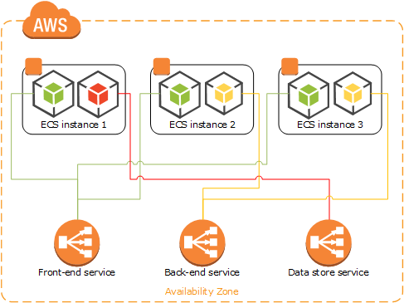
AWS ECS Architecture - An alternative approach
https://docs.aws.amazon.com/AmazonECS/latest/developerguide/application_architecture.html
"you should create task definitions that group the containers that are used for a common purpose, and separate the different components into multiple task definitions"
ECS Task is a logical representation of Containers (load balanced)
https://docs.aws.amazon.com/AmazonECS/latest/developerguide/docker-volumes.html
Deploy Deep Learning Models on Amazon ECS:
https://aws.amazon.com/blogs/machine-learning/deploy-deep-learning-models-on-amazon-ecs/

Slide 30
Analytics environment setup
Component install and Integration | Jupyter Hub, CDAP, MLFLow, All packages, H20
Creating service for CDAP data pull | This will run a pipeline and prepare data for Wrangling
creating service for EDA pull | This service will run the EDA step required
Creating Service for Model | Model as a service for Microservice
* Caution: REST-API has limitation of Data

Slide 31
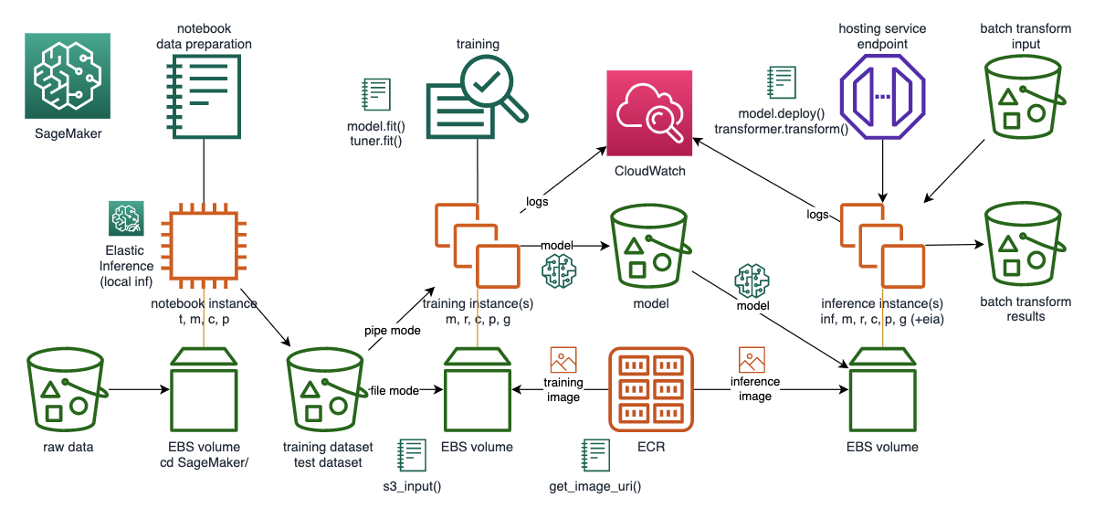
AWS Sagemaker Reference Architecture (Future State on need basis)

Slide 32
Exploratory Data Analysis (EDA)
Identifications of variables and data types
Classification of variables (Discrete, continuous, ordinal and nominal )
Non-Graphical Univariate Analysis
Graphical Univariate Analysis
Bivariate Analysis
Variable transformations
Removing Redundant variables
Missing value treatment
Outlier treatment
Correlation Analysis
Variable transformation(log, Square/cube root or binning)
Derived variable
Dummy variable
Dimensionality Reduction(PCA, Random Forests/Ensemble Trees etc)
Plots
- Correlation Matrix heatmap
- Scatterplot in between different x and y variable, sns.pairplot() etc
- Histogram
- boxplot
-

Slide 33
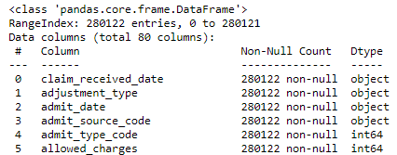
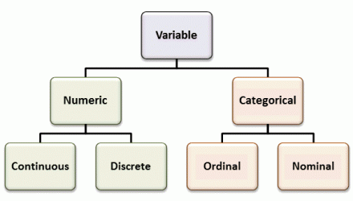
Exploratory Data Analysis (EDA)
Identifications of variables and data types
Classification of variables (Discrete, continuous, ordinal and nominal )

Slide 34
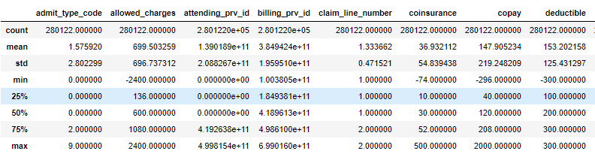
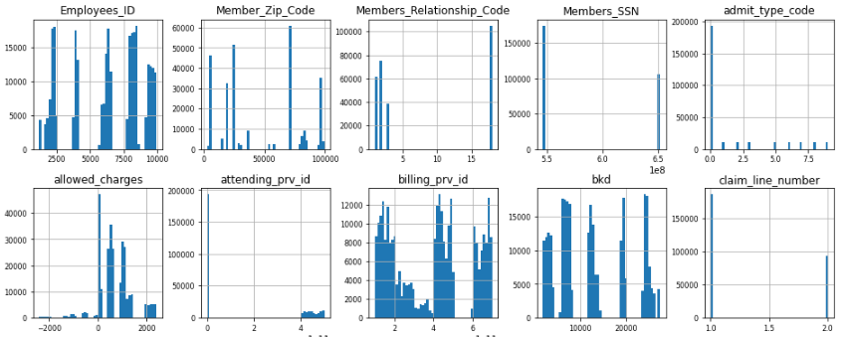
Non-Graphical Univariate Analysis:
Univariate describe a type of data which consists of observations on only a single characteristic or attribute.
Graphical Univariate Analysis

Slide 35
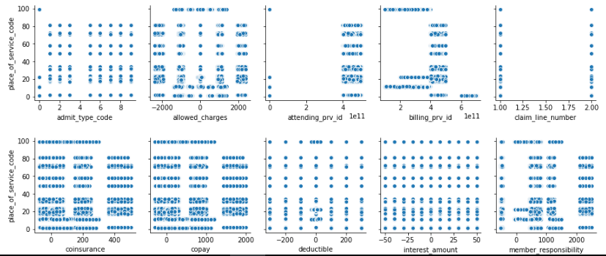
Bivariate Analysis :
Bivariate is a type of inferential statistics that deals with the relationship between two variables. Bivariate statistics examines how one variable compares with another or how one variable influences another variable.
Variable transformations
Variable transformation is the process of converting data from one format or structure into another format or structure.

Slide 36
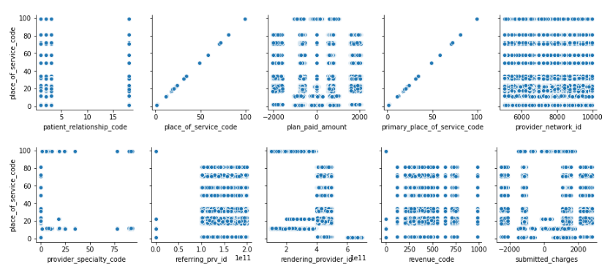
Removing Redundant Attributes:
If variables are duplicated in the training data, it is effectively the same as having its 'weight' doubled. That element becomes twice as important when the classifier is fitting your data, and the classifier becomes biased towards correctly classifying that particular scenario over others.
Missing value treatment
Missing values can be replaced by the minimum, maximum or average value of that Attribute. Zero can also be used to replace missing values. Missing values are common occurrences in data. Most predictive modeling techniques cannot handle any missing values. Therefore, this problem must be addressed prior to modeling. e.g. Mean, median, mode, Regression imputation, K-nearest neighbor (KNN) imputation

Slide 37
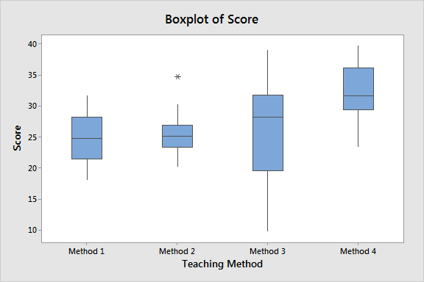
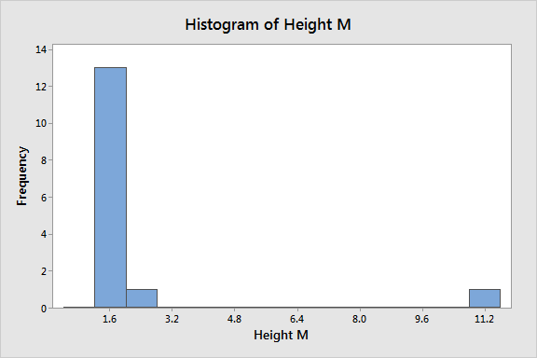
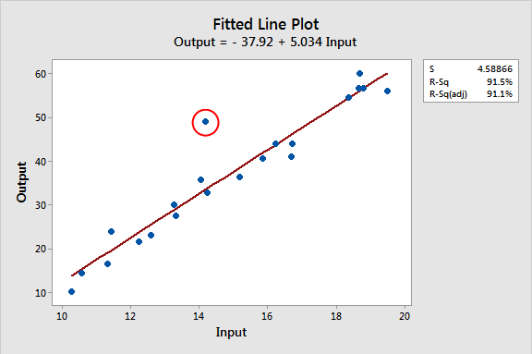
Outlier treatment:
Outliers are data points that are far from other data points. In other words, they’re unusual values in a dataset. there are no rules for definitively identifying outliers. Finding outliers depends on subject-area knowledge and an understanding of the data collection process.
We will follow the following technique to identify outliers.
Sorting Your Datasheet to Find Outliers
Graphing (Box Plot, Histogram, Line plot) Your Data to Identify Outliers
Using Z-scores to Detect Outliers (Preferred method)
Calculating the Outlier Fences Using the Interquartile Range
Note : We will treat only in-practical outliers

Slide 38
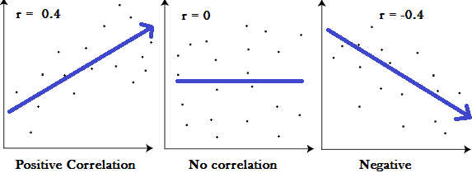
Correlation Analysis:
Correlation is used to test relationships between quantitative variables or categorical variables. In other words, it’s a measure of how things are related. The study of how variables are correlated is called correlation analysis.
Positive correlation exists when two variables move in the same direction.
One of the most common positive correlations is the relationship between demand and price.
Your caloric intake and your weight.
The amount of time your study and your GPA.

Slide 39
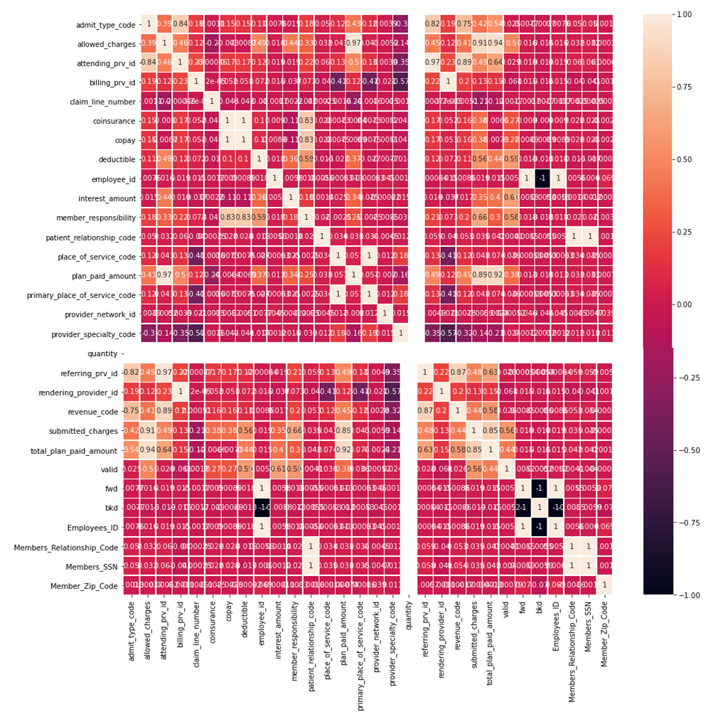
Correlation heatmap:

Slide 40
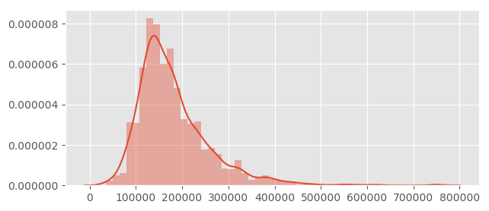
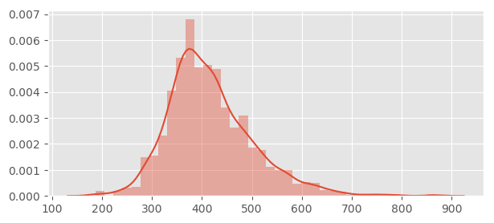
Variable transformation(log, Square/cube root or binning) :
Transformation refers to the replacement of a variable by a function. For instance, replacing a variable x by the square/cube root or logarithm x is a transformation. Or we can say transformation is a process that changes the distribution or relationship of a variable with others.
When should we use Variable Transformation?
Change the scale
Transform complex non-linear relationships into linear relationships
Symmetric distribution is preferred over skewed (odd) distribution
Here, there can be two types of skewed distribution
Left-skewed distribution: we take a square/cube or exponential of variables.
Right-skewed distribution: we take the square/cube root or logarithm of the variable.

Slide 41
Derived Variable :
Sometimes the raw data you obtain from various sources won’t have the features needed to perform machine learning tasks. When this happens, you must create your own features in order to obtain the desired result. You create new features from existing data. In a nutshell, we define feature engineering as creating new features from your existing ones to improve model performance.
Derived variables technique.
Indicator Variables
Indicator variable from thresholds
Indicator variable from multiple features
Indicator variable for special events
Indicator variable for groups of classes
Interaction Features
Sum of two features
Difference between two features
Product of two features
Feature Representation
Date and time features
Numeric to categorical mappings
Grouping sparse classes
Creating dummy variables
External Data
Time series data
External API’s
Geocoding

Slide 42
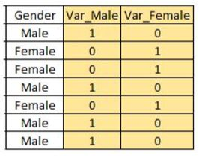
Dummy Variable :
Dummy variables mostly used when we have to convert the categorical variable into numerical variables. Dummy variables are also called Indicator Variables. It is useful to take the categorical variable as a predictor in statistical models.
You will see in a variable gender there are only two types of values “male” and “female”, here will create two new variables “ Var_Male ”and “Var_Female” see in the table below.

Slide 43
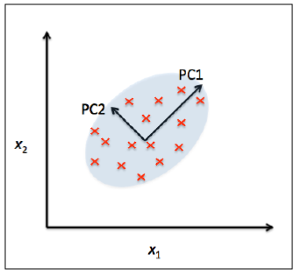
Principle Component Analysis (PCA):
Principal Component Analysis (PCA) is an unsupervised, non-parametric statistical technique primarily used for dimensionality reduction in machine learning. PCA is used to identify the components with the maximum variance, and the contribution of each variable to a component is based on its magnitude of variance. It is best practice to normalize the data before conducting a PCA as unscaled data with different measurement units can give false interpretation.
Performed PCA on Member and Claims data, we have 30 columns their datatypes is numeric. We created two columns which represent features of 30 columns using PCA.

Slide 44
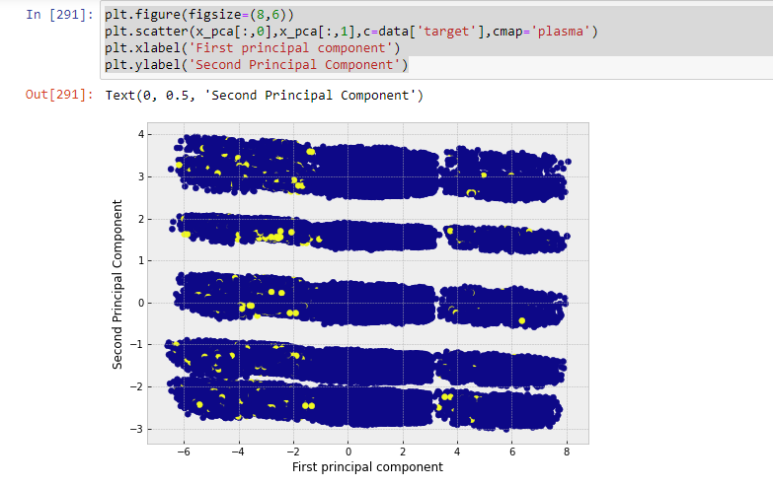

Slide 45


CDAP vs OpenRefine
CDAP
OpenRefine
CDAP provides a clear distinction between infrastructure components and application code.
The best ways to interact with CDAP is using the HTTP REST API.
Can be operated in three different modes - In memory, Standalone, Distributed Data Application Platform
It is useful to have reusable libraries for common Big Data access patterns.
Supports virtualization.
Supports development lifecycle including deployment.
OpenRefine, Desktop application for data cleanup and transformation.
It is a powerful tool for working with messy data, cleaning it, transforming it from one format into another and extending it with web services and external data.
Faceting (Groups all the values that appear in a column, and then allows you to filter the data by these values and edit values across many records at the same time)
Clustering
Editing cells

Slide 46
RESTful API
General APIs
Namespace: creating and managing namespaces
Metadata: setting, retrieving, and deleting user metadata annotations
Preferences: setting, retrieving, and deleting preferences
Configuration: retrieving the CDAP and HBase configurations
Security: granting, revoking and listing privileges on CDAP entities, managing secure storage
Transactions: interacting with the transaction service
Major CDAP Entities APIs
Artifact: deploying artifacts and retrieving details about plugins available to artifacts and classes contained within artifacts
Lifecycle: deploying and managing applications, and managing the lifecycle of flows, MapReduce programs, Spark programs, workflows, and custom services
Stream: sending data events to a stream or to inspect the contents of a stream
Dataset: interacting with datasets, dataset modules, and dataset types
Service: supports making requests to the methods of an application’s services
Route Config: create, fetch, and delete route configurations (route configs) which allocate requests between different versions of a service
Workflow: retrieving values from workflow tokens and statistics on workflow runs
Querying and Viewing APIs
Query: sending ad-hoc queries to CDAP datasets
Views: a read-only view of a stream, with a specific read format
Logging, Metrics, and Monitoring APIs
Logging: retrieving application logs
Metrics: retrieving metrics for system and user applications (user-defined metrics)
Monitor: checking the status of various system and custom CDAP services
Note : Most of the pipeline activities can be created through RESTfulAPI. CDAP provides a number of ways to process data in a pipeline, and one of the most flexible ways to build advanced data processing logic is through the use of directives with Apache JEXL.
https://docs.cask.co/cdap/4.0.0/en/reference-manual/http-restful-api/introduction.html

Slide 47
OpenRefine API
OpenRefine’s Generic API
Create Project
Command : POST /command/core/create-project-from-upload
multipart form-data:
'project-file' : file contents
'project-name' : project name
'format' : format of data in project-file (e.g. 'text/line-based/*sv') [optional]
'options' : json object containing options relevant to the file format [optional]
Fetch the project details
http://127.0.0.1:3333/project?project=<project id>
Export Rows from the project
'project' : project id
'engine' : JSON string... (e.g. '{"facets":[],"mode":"row-based"}')
'format' : format... (e.g 'tsv', 'csv')
Delete project
'project' : project id
Get all projects metadata. Retrieve meta data for all projects. This includes the project's id, name, time of creation and last time of modification.
Command: GET /command/core/get-all-project-metadata
General Refine Expression Language (GREL) used to write data transformations in OpenRefine tool. This tool is used to handle messy data, does not have capabilities to perform data pipeline.
https://github.com/OpenRefine/OpenRefine/wiki/OpenRefine-API

Slide 48
Emergency Room Visit Prediction – Use Case
Objective : With Machine Learning, predict and target members who are potentially ER visitors within future '3' months, repeat or non-repeat
Claims - Historical Claims
Care Management (Not Available)
Survey - Wellness Survey(Not Available)
Member (member demographics)
Provider - Provider location
Source : HCSC UAT masked data.(Aetna data to be used)
100,000 members.
190,000 medical claim records over 3 years.
401,000 Rx claim records over 3 years.
60,000 provider records.
Source Data : Entities
Note : Electronic Health Record is not available, would have been valuable.
Benefit : Benefit Director may launch survey to determine root cause, contact members in risk, providers, suggest alternative methods as tele visit or 24 hours urgent care clinic, and create awareness campaigns for less expensive options.
Methodology of Machine learning :
Data Ingestion and cleaning
Data Wrangling and labeling
Train/Test Dataset in Matrix format
Model training, score and selection
Model deployment, prediction execution
Outcome : Set of members at risk
Exploratory Data Analysis Reports
REST API Service
By product
Source :Aetna data
27900 unique members. (in claims, not total)
210271 medical claim records .

Slide 49
Emergency Room Visit Prediction - Design
Data Processing : In order to prepare data for model, following approach is followed:
Remove null values, sometimes fill by means, validate address and fill up latitude, longitude etc.
Join Member and Claim data to form aggregation at member level, with following consideration.
Consider a time period of last 12 months, added with outcome period of 3 months. Iterate the period over total span of 3 years. Number of ER visits in last 12 months, and its attributes play important role in the outcome prediction.
Consulting with a Doctor, calculated severity score on the diagnosing codes present in claims. - WIP
Consider frequency of claims and ER visits, time-length between visits.
Trend slope (upward, downward, flat) of ER visits in last 12 months
Provider data attributes such as distance, specialty are joined at Member aggregation level.
Calculate the derived features (e.g. Age). Ref : The complete list of dependent variables (features) is available in a spreadsheet.
Member additional information from CRM are joined, mostly lifestyle indicator.
Convert categorical variables into numerical ordinal variables by Weight of Evidence method.
About 70% members do not have claims, about 3% members have Emergency visit. For imbalanced data, SMOTE method was used to balance data.
Model Training, Testing, Prediction :
Primary Language : Python, Jupiter Notebook
ETL :Spark
Database: Druid, Postgress, Elastic Search, S3
Environment : Dev – Akash VM, Prod – AWS EC2, S3. Kubernetes-Docker.
ML framework: H20.ai, scikit-learn, ML flow
DevOps: Git, Jenkins
Frameworks of code (capability) are built for future reuse in Analytics use case.
The solution is portable to another architecture with little customization.
With the processed feature matrix, some pre selected and AutoML models are run.
KPI of recall (error on false negative) prediction is measured, and best model is selected.
In this use case, data would be refreshed monthly and job would be run monthly. The set of member, claim data, and the attributes do not change significantly in less than a month.
With the monthly job run, the predicted members for next 3 months Emergency Room visit would be shared, saved in database and available on REST API.
Model re-training in 6 month or based on accuracy Monitoring
For any prediction we will need one year of historical claim data.

Slide 51
Activities
 | Responsible Teams(R,A,C,I)
1 | DCG, Analytics, API, Testing and UI
2 | DCG, Analytics, API and Testing
3 | DCG, Analytics and Testing
4 | DCG, Analytics and Testing
5a | DCG and Analytics
5b | Analytics
6a | Analytics
6b | Analytics
7a | DCG, Analytics, Testing, Data ingestion
7b | DCG, Analytics
8a | DCG, Analytics, Testing, Data ingestion
8b | DCG, Analytics
9 | Analytics
10 | Analytics and API team
11a | Analytics and API team
11b | Analytics and API team
12 | Analytics UI and API team
1. R2 Analytics Requirement
2.Requirement discussion and Entity identification
3.Data gathering and analysis
4. Discuss with DCG team
For Data dictionary
5a. Analyze Data Model Changes
5b.EDA analysis
6a.Data Model updated and Data Entity created
6b. Modeling
7a.Data Ingestion and File format
7b.Testing and Review
8a.Data ingestion Pipeline and data load
8b.Model Ready
9. Integration of Model with DB
10. Preparation of Model as Api
11a. Input Data processing
11b. Integration with Microservice Api
Pre-requisite before Sprint
12. Integration with UI
During Sprint

Slide 52
EC2 Instance (ECS)
EC2 Instance (ECS)
EC2 Instance (ECS)
Dev Machine2
CDAP
Spark
This machine used for data wrangling.
Dev Machine3
CDAP
Mlflow
Jupyter hub
H20
Spark
This machine used for Model build and training with complete data.
Dev Machine4
Python
H20
flask
Model Deployment
For API

Slide 53











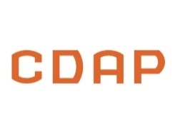
Flask Architecture
Celery Async Task queue
Async
Workers
Invoke
python
HTTP
WSGI server
(handle concurrent requests)
Sync

Slide 54
Asynchronous mode
Invoke
python
First HTTP request
Task added to queue
Task ID
Task ID
Celery Async Task queue
Redis
worker
Invoke
python
Fetch task status
Spark cluster ?
-Model
-EDA
-CDAP pipeline
Task status request
Status
status
status

Slide 55
Synchronous mode
Python code
Druid
Postgressql
Invoke
python
Call appropriate function
Client http request
response
response
response
Spark cluster ?
-Model
-EDA
-CDAP pipeline

Slide 56
Helix Analytics – Logical design
Data ingestion
Nifi pipeline
UI
API Service
Structured vs Un structured Data validation and Cleanup.
Visualization
Wrangling Exploration & Cleaning
Data Acquisition & Understanding
Data Storage
Druid, Postgress, Elastic Search, S3
Transform, Binning
Temporal, Text, Image
Feature Selection
Feature Engineering
AWS EMR
SPARK Cluster
H2O.ai Cluster
Model Training & Selection
Model Deployment
Prediction
Algorithms, Ensemble
Parameter Tuning
Retraining
Model Management
Model Training
Cross Validation
Model Reporting
A/B Testing
Model Evaluation
Scoring, Performance, Monitoring
Refine\Retrain

